Slide 1
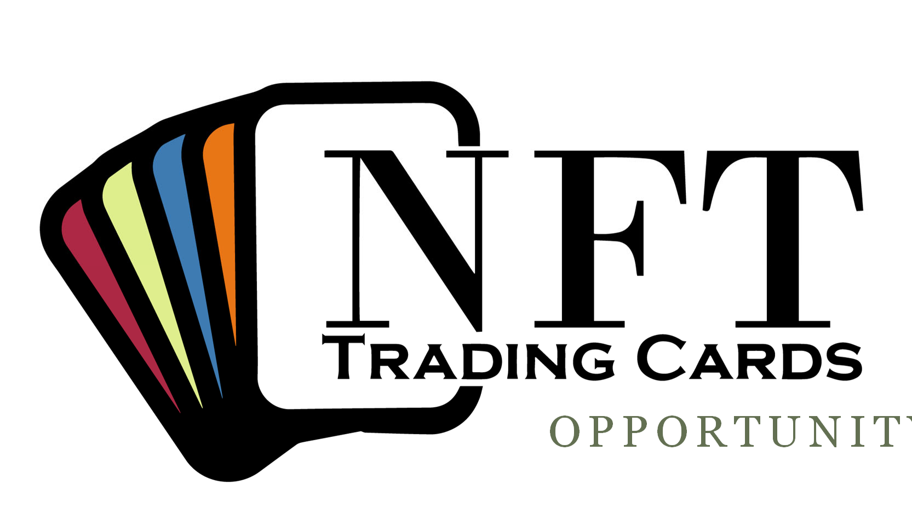
Y DECK
Everyday, a new superstar starts their journey on NFT-tradingcards.biz.
OPPORTUNIT

Slide 2
NFT Trading Cards is a new, unique, next-generation, blockchain technology created to:
Enable users to artistically create one-of-a-kind “player” trading cards online.
Provide an online, easily accessible “marketplace” for creators to find buyers for their unique NFT trading cards.
Create revenue opportunities for Name, Image and Likeness (NIL) programs and for individuals looking for remuneration for their NFT creations.
  Ethereum/Polygon is the payment structure.
  Seamless process for getting paid.
Serve as the “storage” location for all NFT created cards.
Offer space as a “museum” for users and buyers to peruse and purchase, or just admire cards created and shown by owners.

Slide 3
NFT Trading Cards offers Investors:
First-mover advantage to get access to a proprietary technology in the $12.62 Billion trading card industry.
  First-of-its-kind product – and first to market
Equity in a next-gen technology company with minimal expense beyond tech development and marketing with a clear path to profitability within two-three years.
Beneficial timing in the investment as the company’s initial “go-to-market” technology is completed and operational.
Access to management and the investment team in advancing the Company to next levels – who have years of experience in “start-up” businesses.
Interest from several sports organizations already in the works.

Slide 4
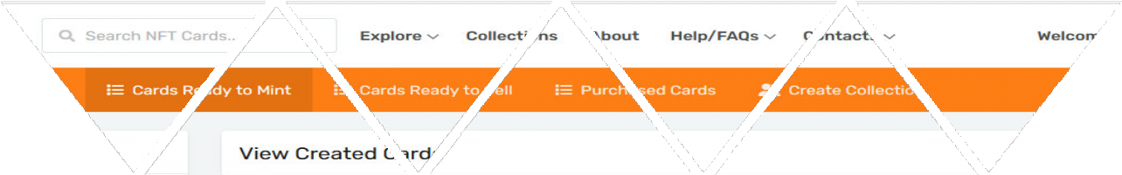
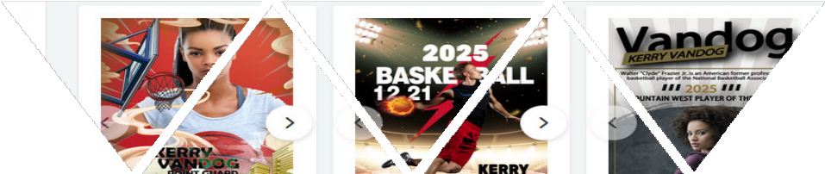
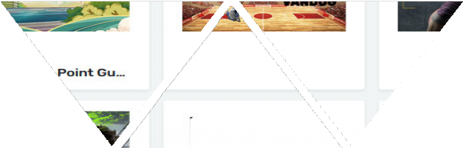

A LITTLE BIT OF HISTORY
NFT Trading Cards serves as the premier NFT Marketplace tailored for trading, crafting, and acquiring trading cards on the Polygon blockchain. This initiative empowers athletes, artists, musicians, performers and influencers of all ages to showcase their Name, Image, and Likeness (NIL) through digital trading card.

Slide 5
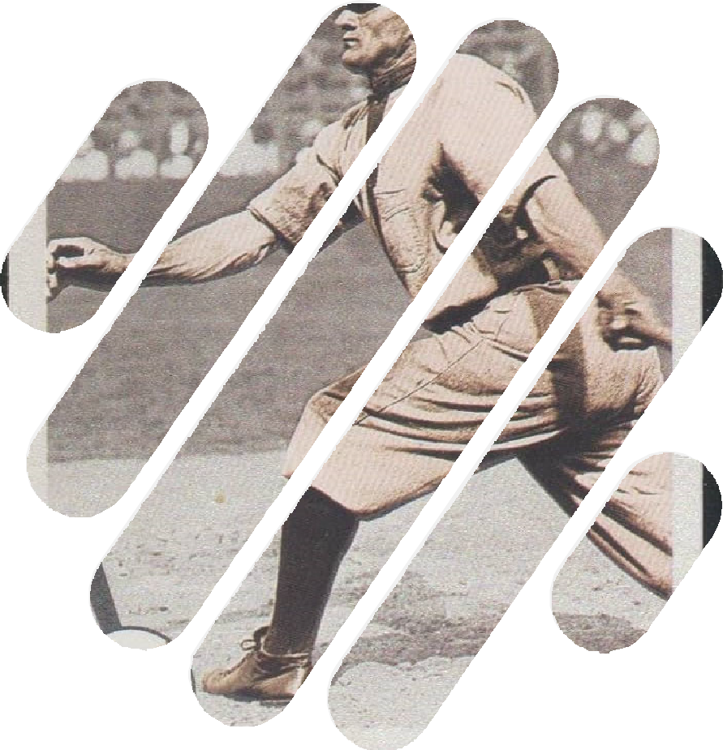
Issue
Traditional trading cards, like any physical product, come with a set of challenges and limitations:
Limited Availability Physical Storage Condition Concerns
Authentication and Counterfeiting Geographical Limitations
Limited Interactivity High Cost of Entry Environmental Impact
Lack of Space for Innovation
https://nft-tradingcards.biz

Slide 6
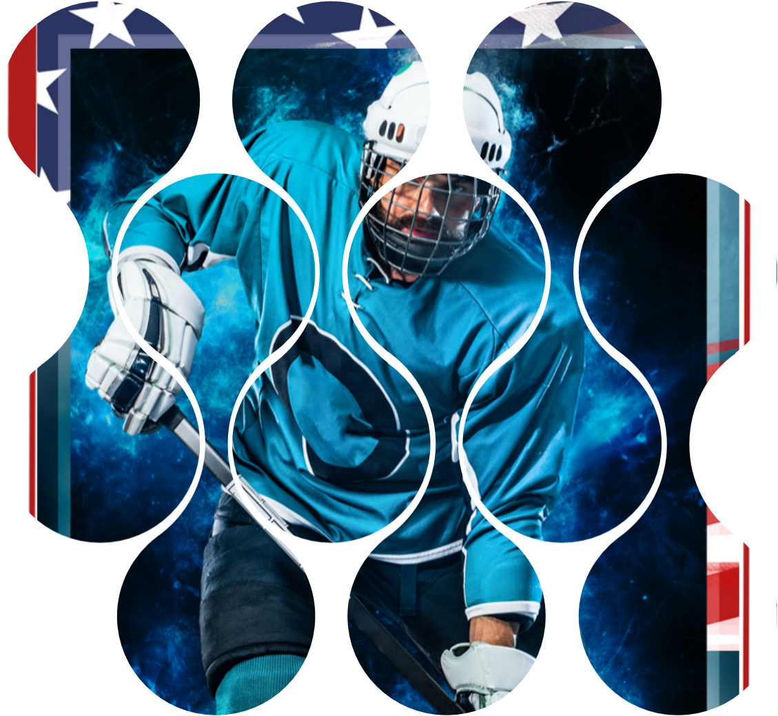
Solution
Digital trading cards on the blockchain offer several advantages over traditional physical trading cards:
Immutable Ownership Global Accessibility Scarcity and Rarity Licensing and Royalties Fractional Ownership Interoperability Programmable Features Instant Transactions
Reduced Environmental Impact Dynamic Content
Storage and Organization Ease of Distribution Durability
Integration with Other Media Community Engagement Decentralized Ownership
https://NFT-tradingcards.biz

Slide 7
Why Now
The surge in NFT (Non-Fungible Token) trading cards is propelled by a combination of technological advancements and evolving consumer preferences. Blockchain technology, particularly on platforms like Ethereum, has streamlined the creation and trading process for digital collectibles, offering features like smart contracts that enforce ownership and authenticity. This technological shift aligns with the growing digitalization of assets, catering to collectors' desires for unique, verifiable digital items like trading cards.
Furthermore, the involvement of celebrities, brands, and influencers, coupled with speculative investment opportunities, has propelled NFTs into the mainstream. High-profile collaborations and endorsements have generated significant interest and buzz, attracting both traditional collectors and newcomers seeking investment opportunities.

Slide 8

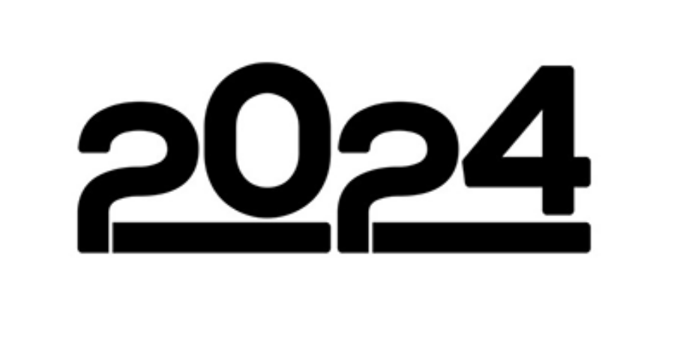
2021
Concep t Born
Allow users to create their own trading card with
an online Trading Card Creation Tool.
2022
Secur e See d Capital
Secured the capital needed to develop Version 1 of the project.
2023
Deplo y System
The marketplace tested and smart contracts deployed.
Version 1 completed. Marketing Started.
2024
Versio n 2 o r V2
Version 2 will be a significant upgrade from Version 1. V1, laid the groundwork for adding Artificial Intelligence (AI), video, selling as packs and
multi-card uploads.
V2 will allow users to comment on posts, much like the functionality found on Facebook, Twitter, and Instagram.

Slide 9
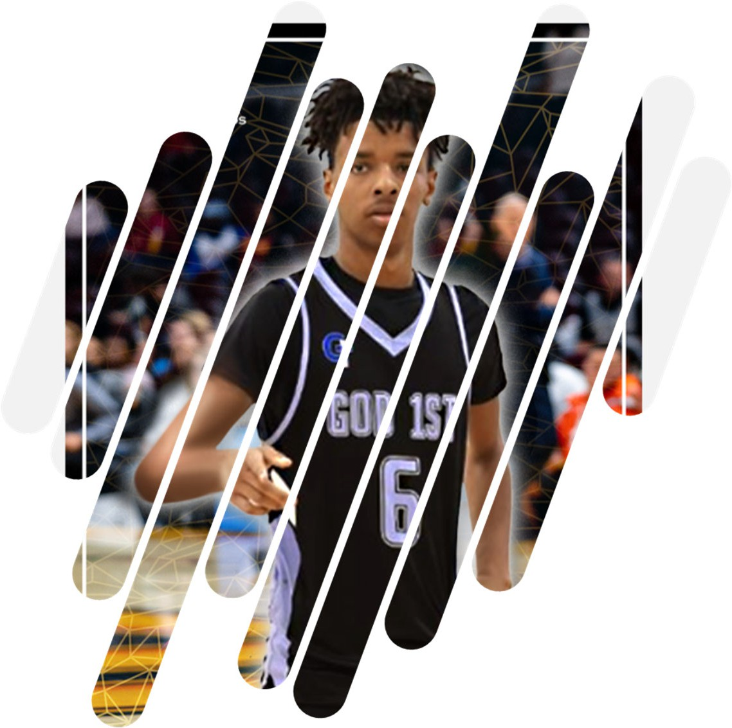
How does this work
We allow users to register a free account. Once registered the user can create their own trading card by using our Trading Card Creation Tool. After creation, the user can mint the card to the blockchain and then list the card for sale on our NFT Trading Cards Marketplace.
https://NFT-tradingcards.biz

Slide 10
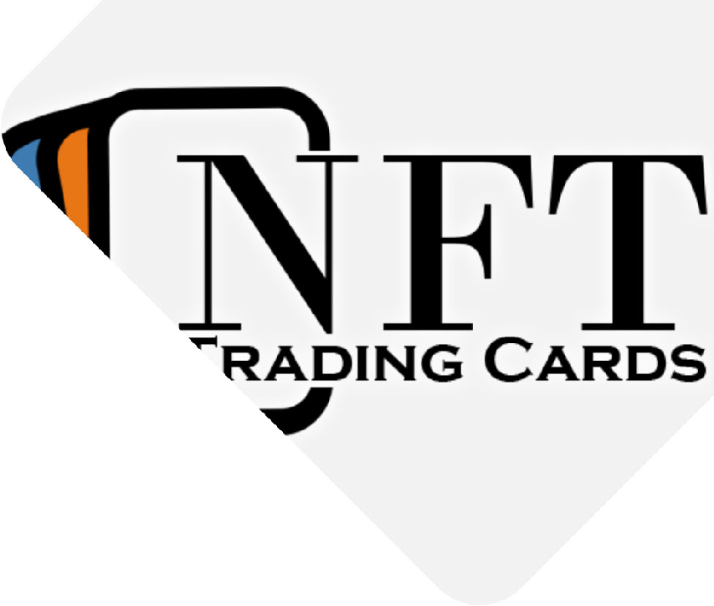
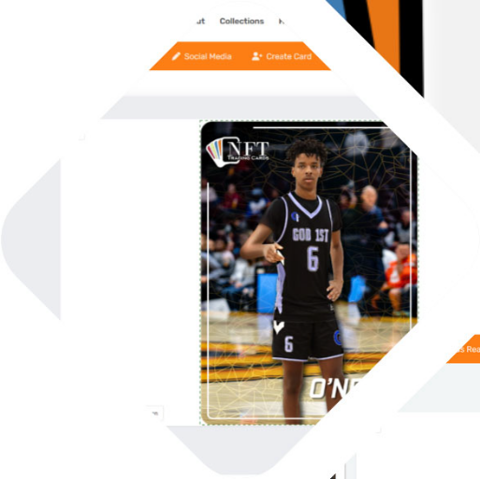
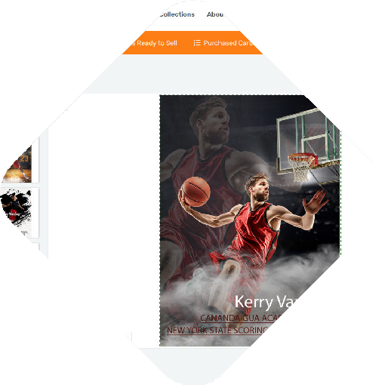
Creating an NFT
(Non-Fungible Token)
Creating an NFT Trading Card offers numerous benefits, such as supporting charitable causes, engaging fans, and generating new revenue streams. Through NFT sales, funds can be raised for important charities and social issues, while fans enjoy unique digital collectibles and exclusive experiences that deepen their connection with creators.
NFTs also provide artists with new revenue opportunities and ensure ongoing royalties from secondary sales. Additionally, they offer secure digital ownership, transparent transaction histories, and investment opportunities as digital assets appreciate in value. Beyond monetization, NFTs foster creativity, innovation, and community building, serving as a new artistic medium and encouraging user-generated content.

Slide 11





Meet the Team
Stephen Steinberger
Founder
Three decades of experience as a Web Developer/Designer.
His expertise spans the full spectrum from front- end design and user experience to back-end coding and database management.
Thinker, Competitor, Friend of Animals Everywhere, Computer Nerd, Internet Evangelist, Sports Junkie.
Charles O’Neill
Partner/Board Member
Kerry Van Iseghem
Partner Member
Jim Aroune
Partner Member
Denzel Gregg
Partner Member
Charles (Chuck) O’Neill has spent the past 26 years creating and founding new healthcare companies, new departments for existing healthcare companies, and consulting with new and emerging healthcare entities to grow their businesses.
Kerry Van Iseghem work experience includes serving as the Chief Executive Officer and Chief Operating Officer at O'Neill Marketing, where he also serves as a share holding Partner.
Jim led the launch of new businesses and new departments and developed innovative business solutions during 36-years of service as an award-winning broadcast and print journalist and broadcast industry executive.
After completing his undergrad degree, Denzel spent three years playing professional basketball in Europe.
Denzel completed his MBA, with a focus on Business Analytics, through St.
Bonaventure’s Online MBA Program.

Slide 12
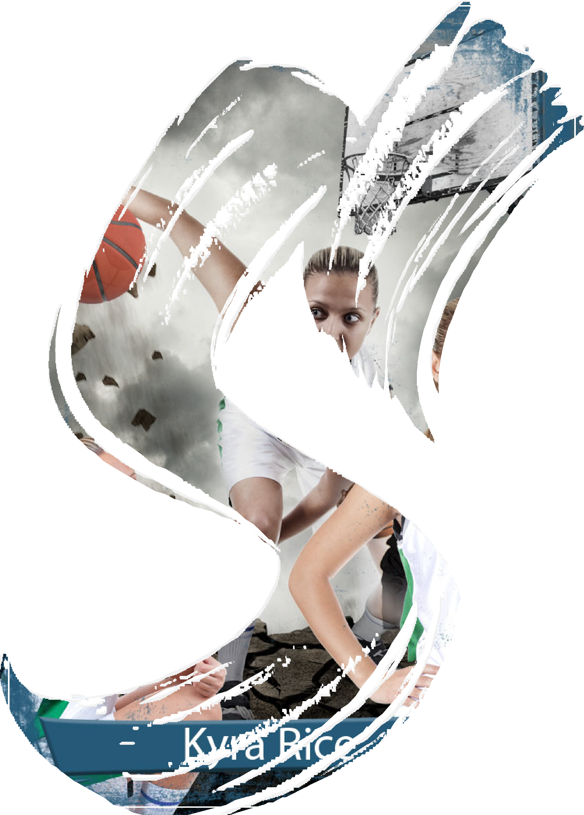

























Strengths
Unique Asset Representation:
  NFTs can represent unique digital and physical assets, such as art, music, real estate, and more, offering unique ownership experiences.
Decentralization:
  The decentralized nature of blockchain ensures that NFTs are resistant to censorship and tampering, providing security and trust.
Smart Contracts:
  Smart contracts automate and enforce the terms of transactions, reducing the need for intermediaries and ensuring transparency.
Growing Market Demand:
  There is increasing interest and demand for NFTs, especially in the art, gaming, and collectibles sectors.
Global Accessibility:
  NFTs and blockchain platforms are accessible globally, allowing creators and buyers to interact without geographical restrictions.
Royalty Features:
  NFTs can include built-in royalties, enabling creators to earn a percentage of future sales automatically.

Slide 13

Weaknesses
Technical Complexity:
  NFTs can be technically complex, posing a barrier to entry for non-technical users.
High Transaction Fees:
  Platforms like Ethereum can have high gas fees, making transactions expensive, especially during network congestion.
Environmental Concerns:
  The energy consumption of certain blockchain networks, particularly those using proof-of-work, raises environmental concerns.
Market Volatility:
  The value of NFTs and cryptocurrencies can be highly volatile, posing financial risks to investors and creators.

Slide 14

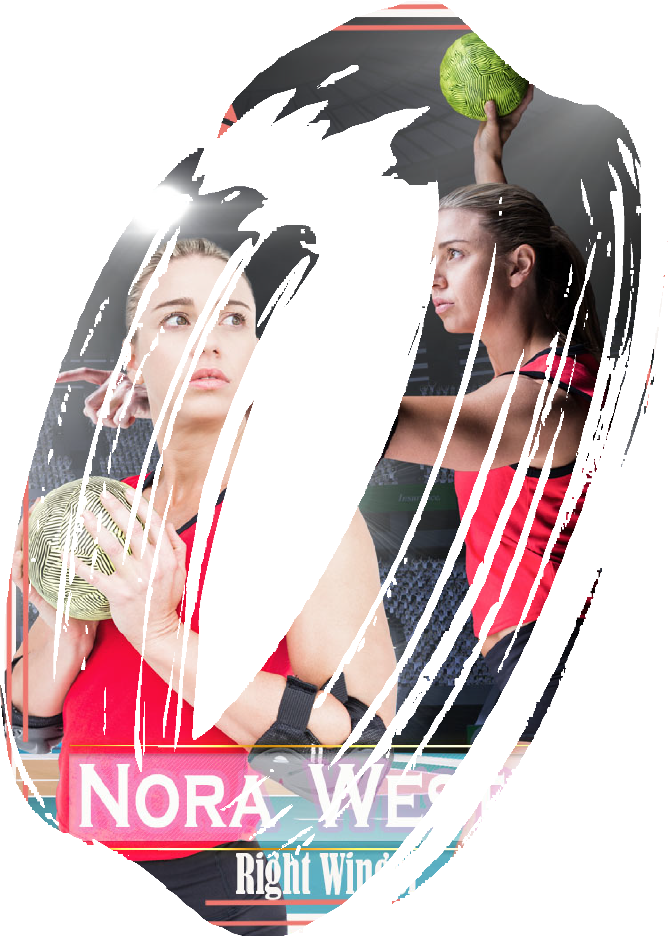
Opportunities
Expanding Use Cases:
  NFTs can be used beyond art and collectibles, including in real estate, ticketing, virtual worlds, and more.
Partnerships and Collaborations:
  Collaborations with artists, brands, and influencers can expand market reach and enhance the value proposition.
Evolving Technologies:
  Advances in blockchain technology, such as layer 2 solutions and proof-of-stake consensus, can address current limitations and improve efficiency.
Growing Institutional Interest:
  Increasing interest from institutional investors can lead to more significant capital inflows and market stability.
Regulatory Clarity:
  As regulatory frameworks evolve, clearer guidelines can provide a more stable and predictable environment for growth.

Slide 15
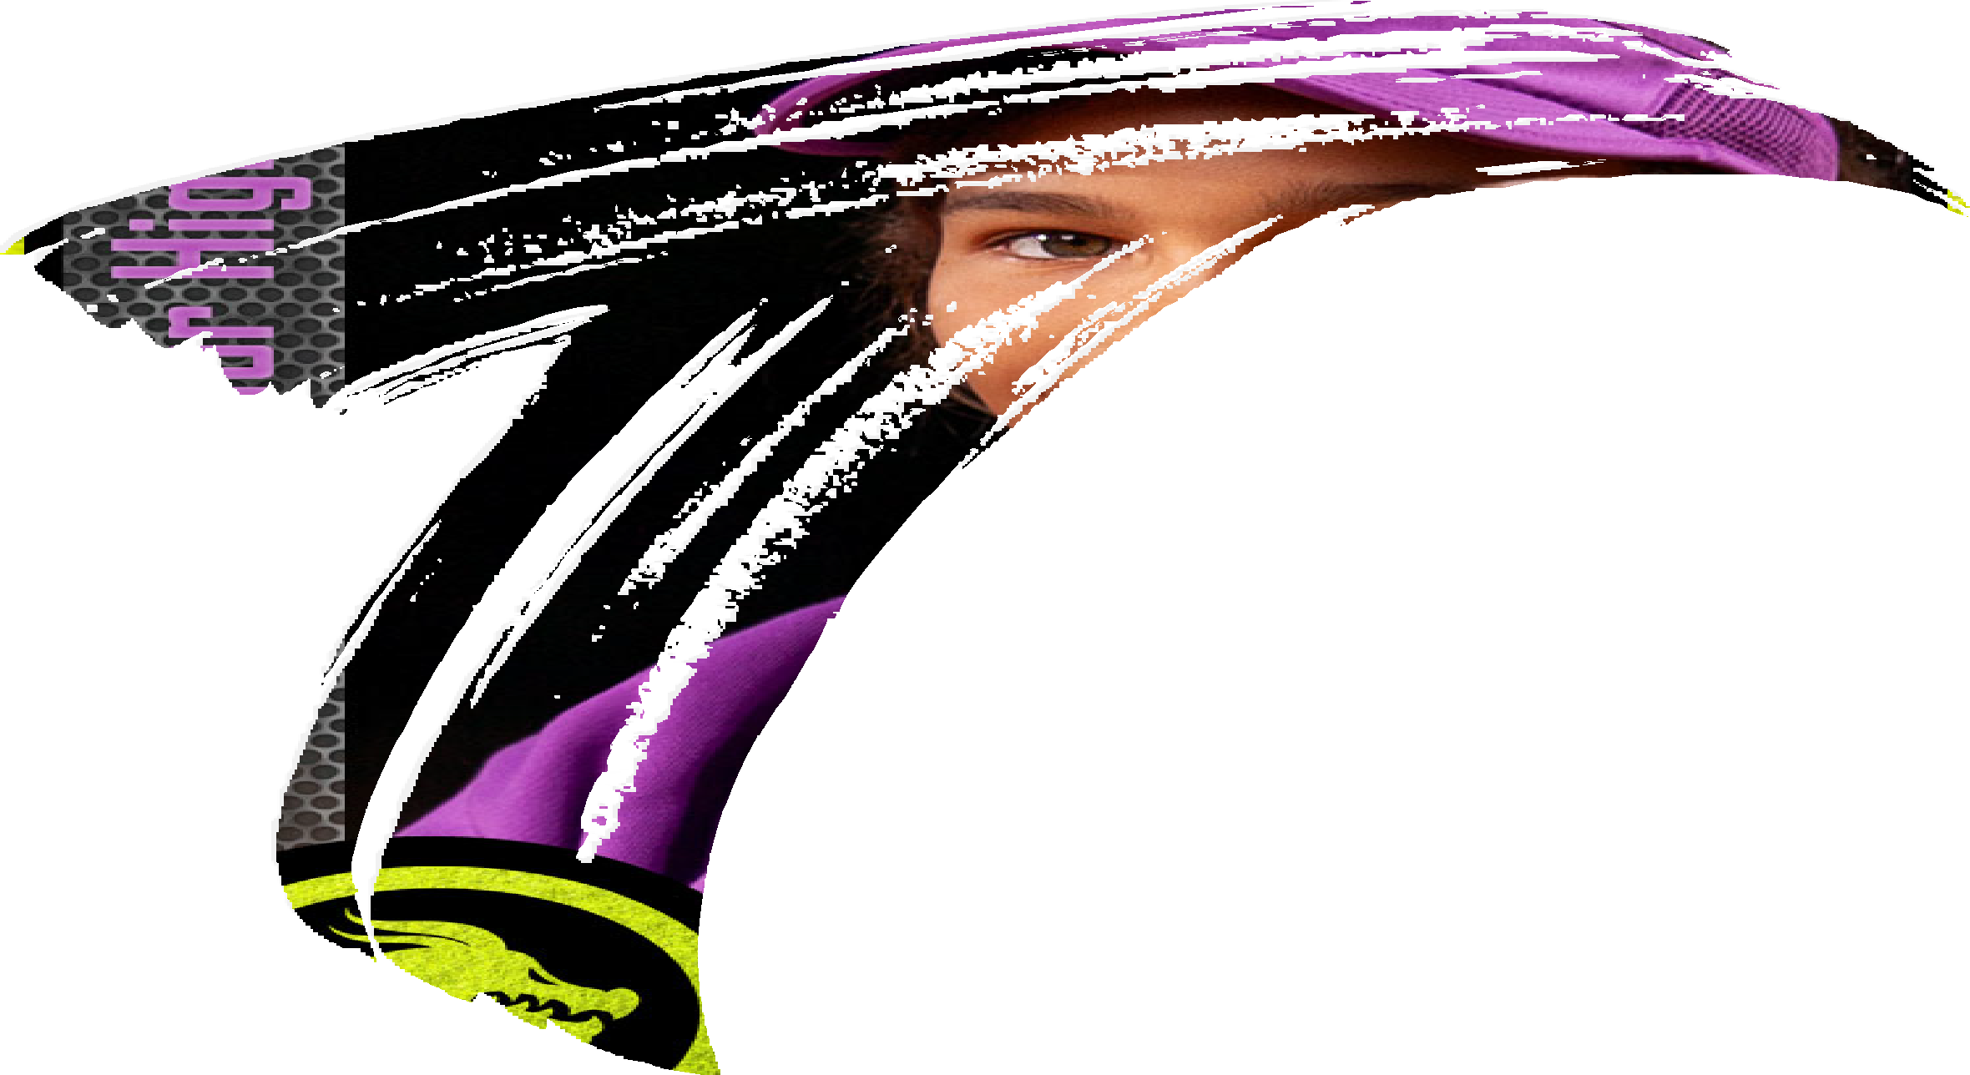
Threats
Regulatory Uncertainty:
  Unclear or unfavorable regulations could pose significant challenges, including potential restrictions or bans.
Security Risks:
  Hacking, smart contract vulnerabilities, and phishing attacks pose risks to users and the platform.
Environmental Criticism:
  Ongoing concerns about the environmental impact of blockchain technology could lead to negative publicity and potential regulatory action.
Fraud and Scams:
  The prevalence of fraud and scams, such as fake NFTs and rug pulls, can erode trust in the market.
Economic Downturns:
  Economic downturns or recessions can lead to reduced investment in speculative assets like NFTs.

Slide 16
The secret of getting ahead is getting started.
Mark Twain.

Slide 17
Market Stats
Global Sports
$403 Billion 2022 expected to be worth over 680 billion by 2028
Youth Sports Market
$37.5 billion in 2022 Projected to grow to
$69.4 billion by 2030
NCAA Sports
$1.3 Billion
Sports Card Industry
USD 12.62 Billion in 2024 Projected to reach USD 23.08 Billion by
2031. Growing at a CAGR of 7.80%.

Slide 18
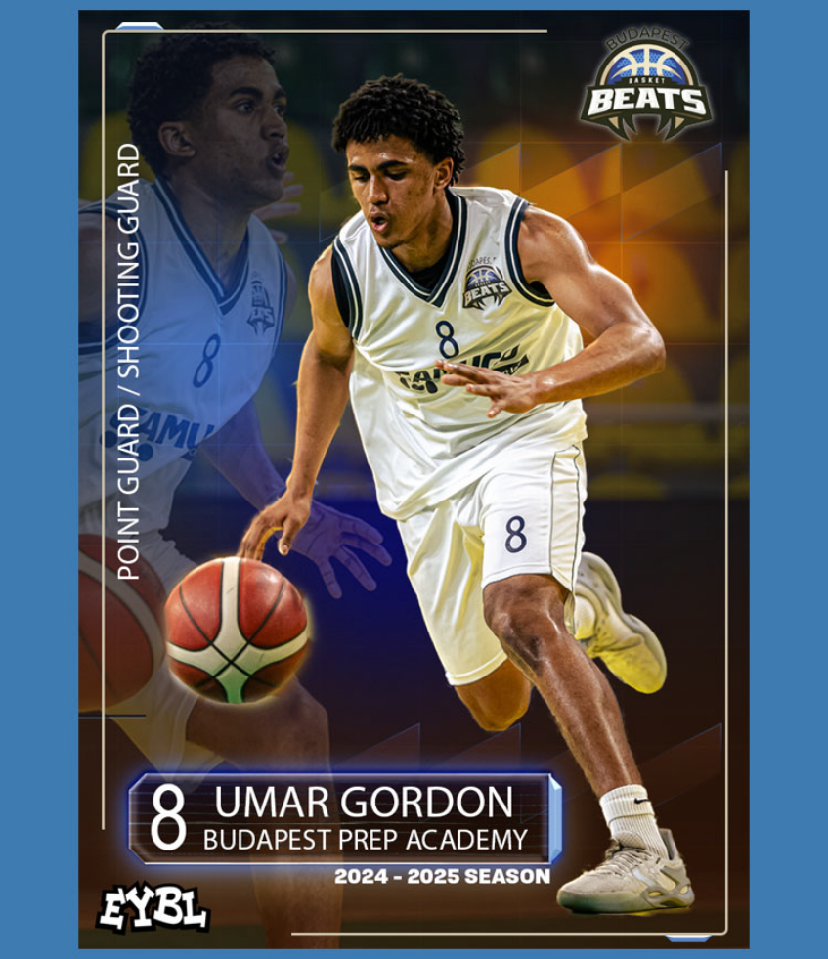



Strategic Partner Secured
European Youth Basketball League (EYBL) is the biggest and the only FIBA certified youth league in Europe.
38 Countries
300+ Teams
4000+ Players
Official EYBL Trading Card

Slide 19
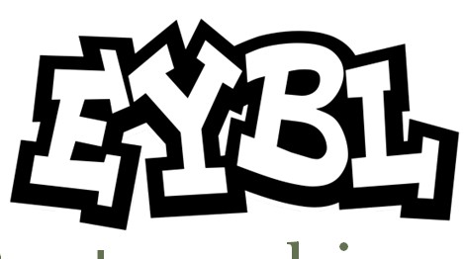
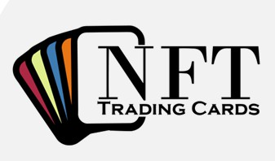
Strategic Partnership with The EYBL
Exclusive Agreement with The European Youth Basketball League
"Prodigy in the Making": The EYBL has been a key influence in the careers of numerous basketball stars now seen in the NBA and abroad.
4,000-5,000 Players Across 38 Countries: Access to a diverse and extensive talent pool.
Exclusive Rights to Create and Distribute NFTs: Capture the journey of rising basketball talents.
Scalable Opportunities for Collectors and Fans: Engage with the future stars of basketball through exclusive digital collectibles.
Market Potential: Tapping into the growing intersection of sports and digital collectibles, with a focus on future NBA stars.
Partnering with the EYBL, NFT-tradingcards.biz is set to leverage this league’s legacy of nurturing future basketball greats, offering investors unparalleled access to the next generation of sports icons.

Slide 20
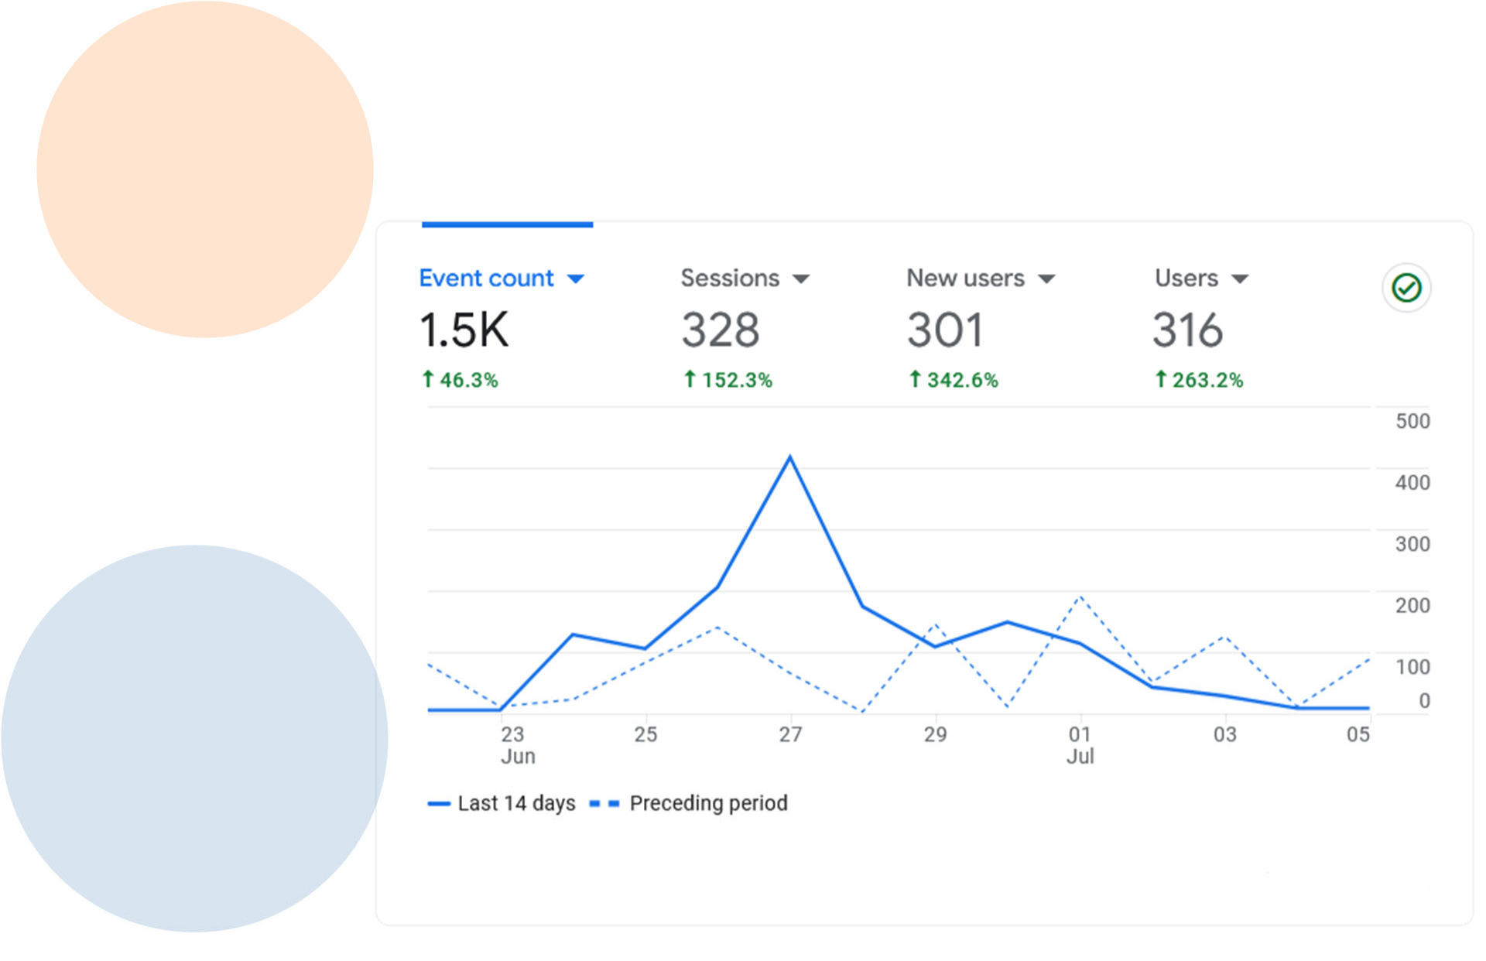
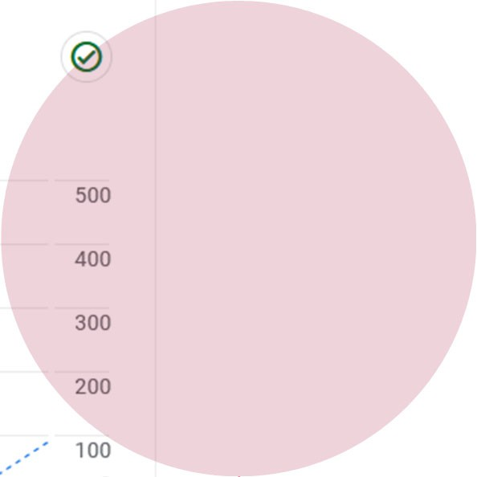
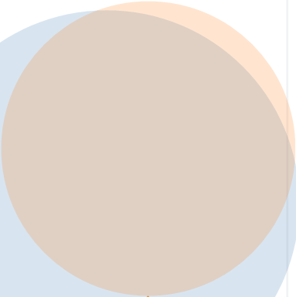
Google Analytics NFT Trading Cards
14 day

Slide 21
Development Timeline
Funds Distributio n
1
First Distribution of $100,000
2
Week 1
Add test server for development testing. Assign and start the coding for Artificial Intelligence (AI), Video cards,
Multi-card uploads, Selling cards in packs, Ability to comment on
cards
Week2
3
Develop smart contract for splitting sales. Add the video capability
4
Week 4
.
Finish/test smart contract for splitting sales. Add the video capability. Hire P/T Social Media
person
Week 5
5
Assign the other smart contracts that need to be created

Slide 22
6
Week 7 - 1 2
Test, Design, Test, Program, Test
Week 13
7
Audit report and group seminar to review progress. Release $100,000 to the operating fund
8
Week 14
Hire P/T media sales rep to introduce NFT Trading Cards and
new partners
Week 15 -18
9
Final Test, Debug, Test
10
Week 20
Week 20-21
V2 and V2.5 is live
11
Consider alternative marketing strategies. Hiring athlete, influencers to promote our service
12
Week 24
Audit report and group seminar
to review progress.

Slide 23
Use of Funds
Salaries
$ 30k
Salaries Include: Lead Creative, Smart Contract/Blockchain Prog, PHP
Programmer, Social media/Lead generator
Paid Service
$15k
$ 40 k
Paid Service Include: Hosting Accounts, Backup Services, Malware Protection, Lead Gen, Email Services, Phone Services
Paid Marketing
Industry Trade Events
$ 5 k
Paid Marketing Includes: Subscriptions to online companies like Sports Marketing and Sports Influencer Agency.
Technology Development
$ 95 k
Industry Trade Events Include: NIL Summits and Card Shows
L egal/Administrative/Insurance
$ 15 k
Legal/Administrative Reserve Cash

Slide 24
From Concept to Exit
2021 - Platform Concept Born:
Allow users to create their own Trading card with an online Trading Card Creation Tool.
2022 - Secured Seed Capital:
Secured the capital needed to develop Version 1 of the project. This included two investors for $75,000 and the founder for $65,000.
2023 - Deploy System:
The marketplace tested, and smart contracts deployed. Version 1 completed. Marketing Started.
2024 - Version 2 or V2:
Version 2 will be a significant upgrade from Version 1. V1, laid the groundwork for adding Artificial Intelligence (AI), Video, Multi-card uploads, Creation card packs, Dynamic NFT investor strategies and Archiving. We are seeking $500,000 second round financing.
Version 3 will allow users to comment on posts, much like the functionality found on Facebook, Twitter, and Instagram.
2028(29) - Exit Strategy:
As we digitize and revolutionize the trading card industry for athletes, artists, performers, musician’s, influencers, we will have introduced the concept of commenting, posting, and creating conversations like the way the modern social media platform’s function. This positions us for potential acquisition by a social media giant or a leading sports trading card manufacturer.

Slide 25

Th e Company
The NFT-Trading Cards, LLC. is a organized under Florida law. Headquarters are located in West Palm Beach, Florida.
Curren t Ownership
Term Sheet
NFT-Trading Cards, Inc. (“hereinafter, the Company”) is a privately-held corporation providing for the creation, dissemination, management and hosting of Non-Fungible Tokens (NFTs) and other blockchain services for individuals to create and sell using the Company’s own proprietary technologies and online marketplace.
The Company is privately owned by Steven Steinberger as principal owner and Founder. Minority owners are Charles O’Neill, Kerry Van Iseghem, Denzel Gregg and James Aroune (collectively, the “Owners”).
Investment:
The Company is seeking $200,000 in equity investment.
Investmen t Objectiv e an d Strategy
The Company will use the raised funds to:
The Company is offering an equity investment opportunity only.
Introduce a 2.0 version
Improve operability
Market to strategic partners
Hire programmers, social media manager and marketing
Use for general daily operational costs
Legal fees
Closin g Dates
The Company would like to complete fundraising by February 1, 2025.

Slide 26
Pro Forma
 | Participants | Sales/Rev/X | Av. Rev Per | Total Rev | NFT Portion | Annual Spend
Year 1 | 1,200 | $100/10 | $1,000 | $1,200,000 | $60,000 | $200,000
Year 2 | 3,400 | $120/10 | $1,200 | $4,080,000 | $204,000 | $350,000
Year 3 | 9,000 | $120/10 | $1,200 | $10,800,000 | $540,000 | $400,000
Year 4 | 21,000 | $140/10 | $1,400 | $29,400,000 | $1,470,000 | $500,000
Year 5 | 33,000 | $140/10 | $1,400 | $46,200,000 | $2,310,000 | $600,000
*10 = the number of cards produced by each participant
Revenue does not reflect resales that we believe will have a 100% higher value
Participants reflect high school and college sports only
Spend reflects all costs associated with operations of the Company for the fiscal year

Slide 27
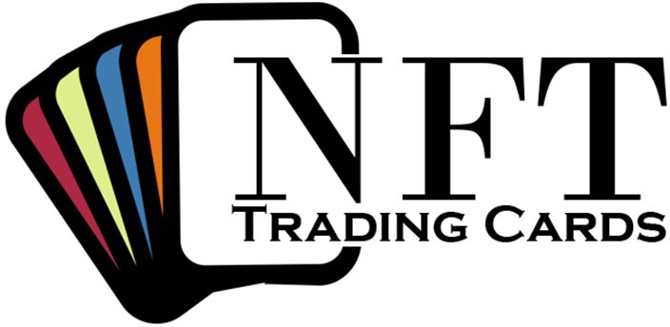
Everyday, a new superstar starts their journey on NFT-tradingcards.biz.

